Slide 1
Laser Arcade Project
Alex Wheelock

Slide 2
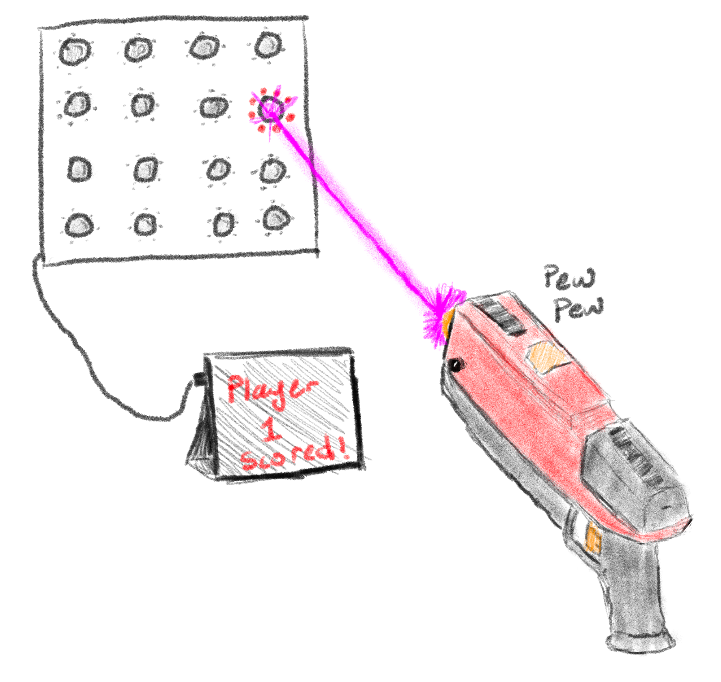
What is the Laser Arcade Project?

Slide 3
Spring 2025 Goals
Create functional blasters
Modify NERF blasters to house electronics, and make the slide function with the solenoid.
Make minor adjustments to the schematic of the blaster.
Design a PCB and 3D Model the parts needed.
Create a functional target
Finish programming the master and slave (target) PICs, and work out bugs in the I2C communication.
Create a target that allows both receivers to see the laser.
Write a VB program which talks to the master, that allows the user to start/stop a game, keep track of and display the score to the users.
Design a PCB for both the master and slave boards.

Slide 4
What Could I Use Help With?
Finalizing Schematics, and designing PCBs.
Writing the VB program to handle the display of scoring and timing, as well as setting up the communication to the master PIC.
Modifications to the blaster, including 3D modeling.

